Slide 1
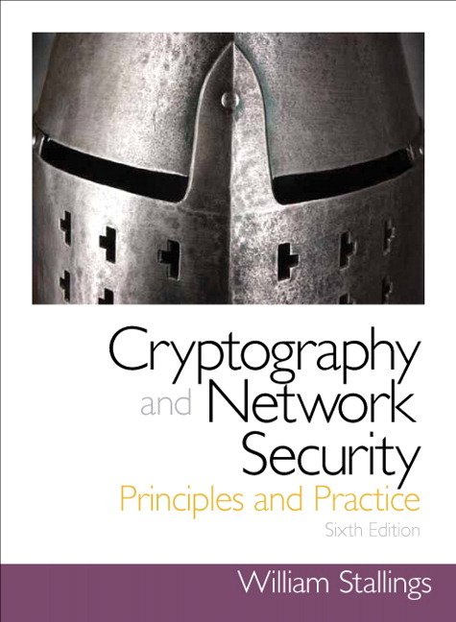
Introduction to Cryptography
Based on: William Stallings, Cryptography and Network Security.

Slide 2
Chapter 1
Overview

Slide 3
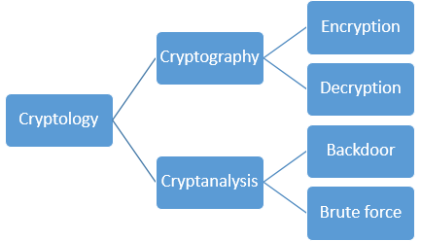
Cryptology

Slide 4
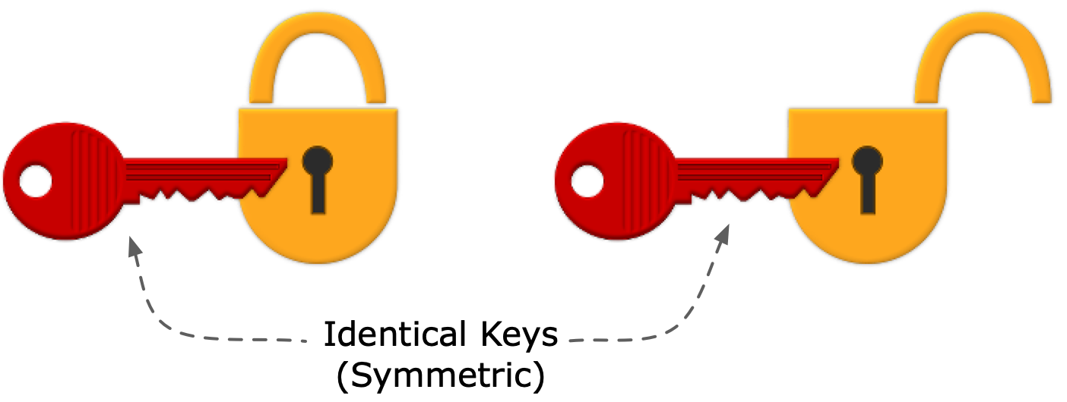

Cryptographic algorithms and protocols
Symmetric encryption (one secret key)
Conceal the contents of blocks or streams of data, using a secret key. The same key as used for decrypting.
Asymmetric encryption (a public and a private key)
Conceal the contents of blocks of data, using a public key. A private key is used to retrieve the contents of the blocks.
Data integrity algorithms
Protect blocks of data, such as messages, from alteration
Authentication protocols
Authenticate the identity of entities

Slide 5
Computer Security Objectives
Confidentiality
Data confidentiality
Sensitive information is not available or disclosed to unauthorized individuals
Privacy
Individuals control or influence what information may be collected and stored and by whom and to whom that information may be disclosed
Integrity
Data integrity
Information and programs are changed only in a specified and authorized manner
System integrity
A system performs its intended function in an unimpaired manner, free from deliberate or inadvertent unauthorized manipulation of the system
Availability
Systems work promptly and service is not denied to authorized users

Slide 6
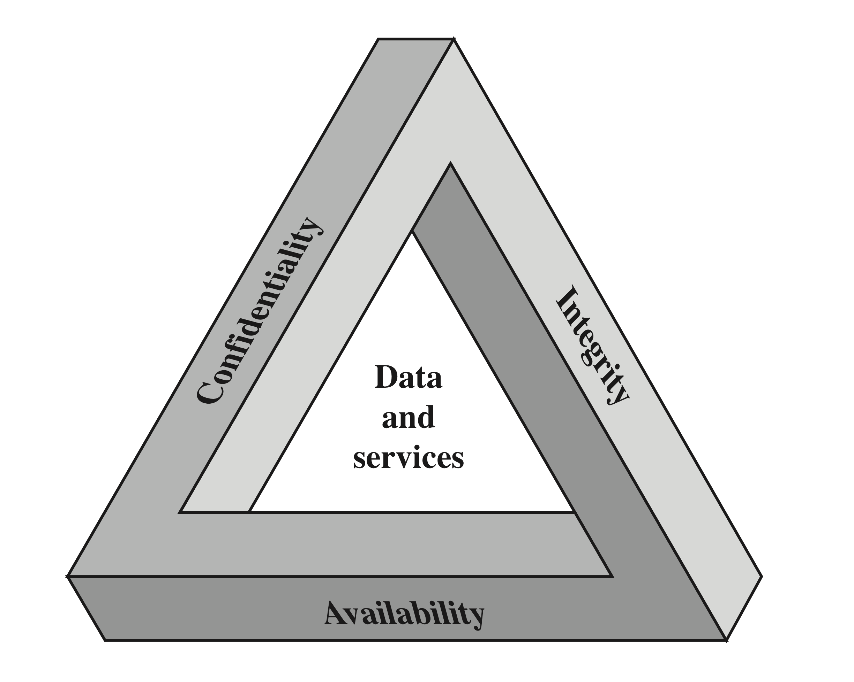
CIA Triad

Slide 7
Additional objectives
Authenticity
Users are who they say they are and each input arriving at the system came from a trusted source
Examples: access to services
Access to a terminal: use password
Access to iPhone (2F): use password+facial recognition
Access to account on ATM (2F): credit (debit) card + PIN
Access to FSU Lab: FSU card
(Entity authentication)

Slide 8
Additional objectives
Accountability
Examples: access to services
The previous examples with ATM and iPhone.
Also digital signatures for data (but not HMACs)
Actions of an entity can be traced uniquely to that entity

Slide 9
Breach of Security Levels of Impact*
High
The loss could be expected to have a severe or catastrophic adverse effect
Moderate
The loss could be expected to have a serious adverse effect
Low
The loss could be expected to have a limited adverse effect
* FIPS (Federal Information Processing Standard) PUB199

Slide 10
Security Challenges
Security is not simple
Potential attacks on the security features need to be considered
Procedures used to provide particular services are often counter-intuitive
It is necessary to decide where to use the various security mechanisms
Requires constant monitoring
Is too often an afterthought
Security mechanisms typically involve more than a particular algorithm or protocol
Security is essentially a battle of wits between a perpetrator and the designer
Little benefit from security investment is perceived until a security failure occurs
Strong security is often viewed as an impediment to efficient and user-friendly operation

Slide 11
OSI* Glossary
Security attack
Any action that compromises the security of information or services
Security mechanism
A process (or a device incorporating such a process) that is designed to detect, prevent, or recover from a security attack
Security service
A processing or communication service that enhances the security of the data processing systems and the information transfers of an organization
* Open System Interoperability (International Telecommunication Union--ITU)

Slide 12
Threats and Attacks (RFC* 4949)
Threat
A potential for violation of security, which exists when there is a circumstance, capability, action, or event that could breach security.
Attack
An assault on system security that derives from a threat.
* Request For Comments (usually from the Internet Engineering Task Force).

Slide 13
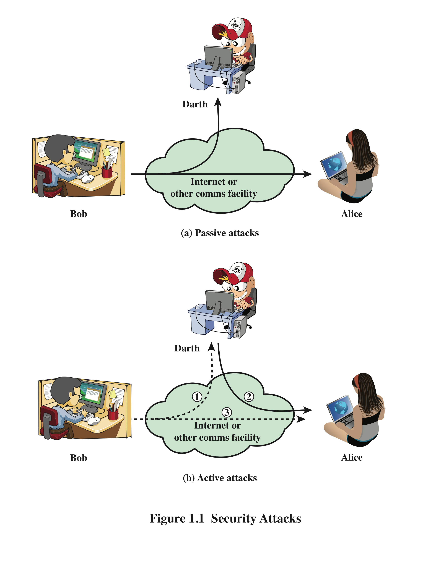
Security Attacks
A passive attack attempts to learn or make use of information from the system but does not affect system resources
An active attack attempts to alter system resources or affect their operation

Slide 14
Passive Attacks
Eavesdropping on, or monitoring of, transmissions
Two types of passive attacks:
The release of message contents
Traffic analysis

Slide 15
Active Attacks
Masquerade
One entity pretends to be a different entity
Replay
The passive capture of data and its subsequent retransmission
Modification of messages
A message is altered, or messages are delayed or reordered
Denial of service
Prevent or inhibit the normal use or management of communications facilities
Modification of data, disruption or creation of a false data

Slide 16
History of Cryptography an overview
Contributions to Security and Cryptography

Slide 17
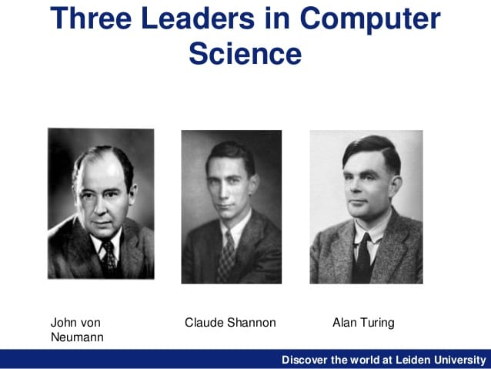
John von Neumann, Clause Shannon, Alan Turing
John von Neumann (1903-1957), Hungarian American mathematician, physicist, computer scientist, with perhaps the widest coverage of any mathematician of his time, known as the “father of Game Theory”.
Claude Elwood Shannon (1916 -2001), American mathematician, computer scientist, cryptographer, known as the “father of Information Theory”.
Alan Mathison Turing (1912-1954), English mathematician, computer scientist and cryptanalyst, highly influential in the development of theoretical computer science, artificial intelligence, “known as the father of Cryptography”.
Famous papers:
On computable numbers, with an application to the Entscheidungsproblem,1936
Computing Machinery and Intelligence, 1950
Entscheidungsproblem = Decision problem: given all the axioms of math, is there an algorithm that can tell if a proposition is provable?

Slide 18
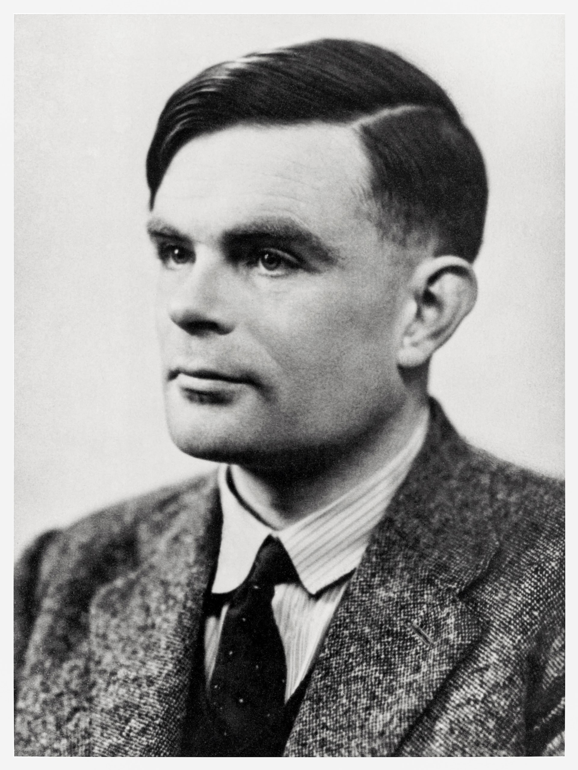
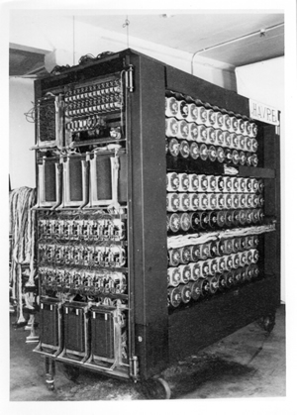
Alan Turing
Computer scientist, cryptanalyst, mathematician, philosopher
An initial design of the Bombe produced in 1939 by Alan Turing
[Bombe: emulates several hundred Enigma rotors, and functions as a logical electrical circuit to automate the deductions needed]

Slide 19
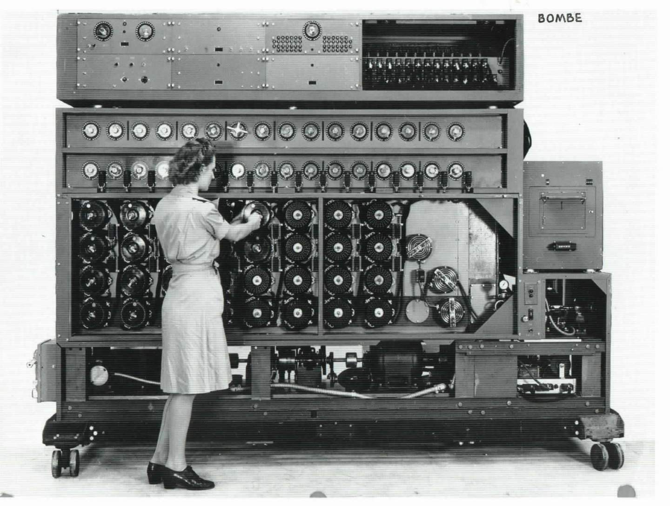
Navy WAVE working on US Navy Cryptanalytic Bombe (Women Accepted for Volunteer Emergency Service)
ULTRA

Slide 20
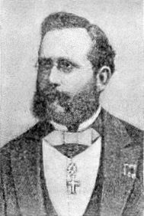
Auguste Kerckhoffs
Auguste Kerckhoffs (1835-1903): a Dutch linguist and cryptographer. Best known for his principles of practical cipher design.

Slide 21
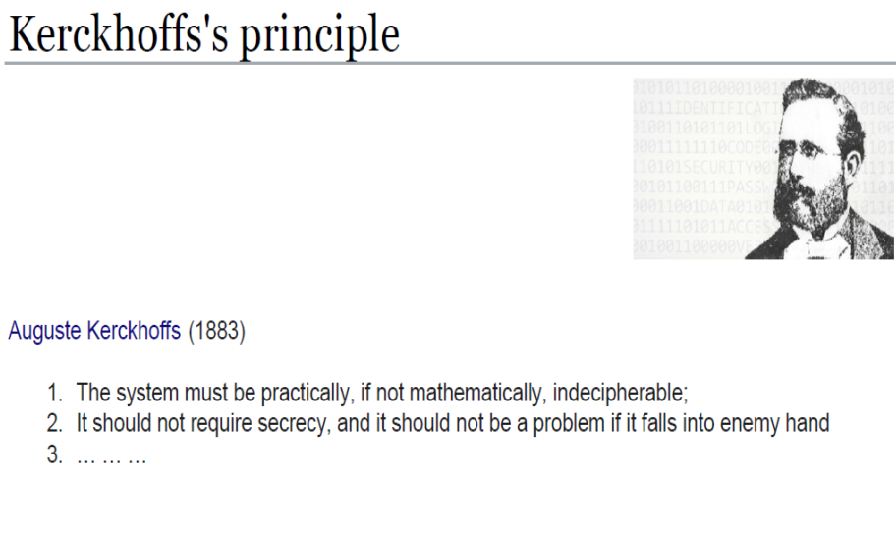
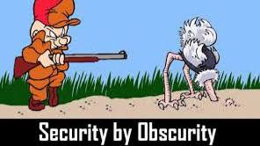
Kerckhoffs
It must be possible to communicate and remember the key without using written notes, and correspondents must be able to change or modify it at will;
…..

Slide 22
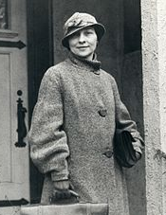
Auguste Kerckhoffs, Elizabeth Smith Friedman
Elizabeth Smith Friedman (1892-1980): an American cryptanalyst and author who deciphered enemy codes in both World Wars. Over the course of her career, she worked for the US Treasury Department, Coast Guard (decoding bootleggers/smugglers messages), Navy and Army.

Slide 23
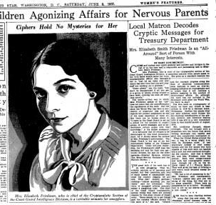
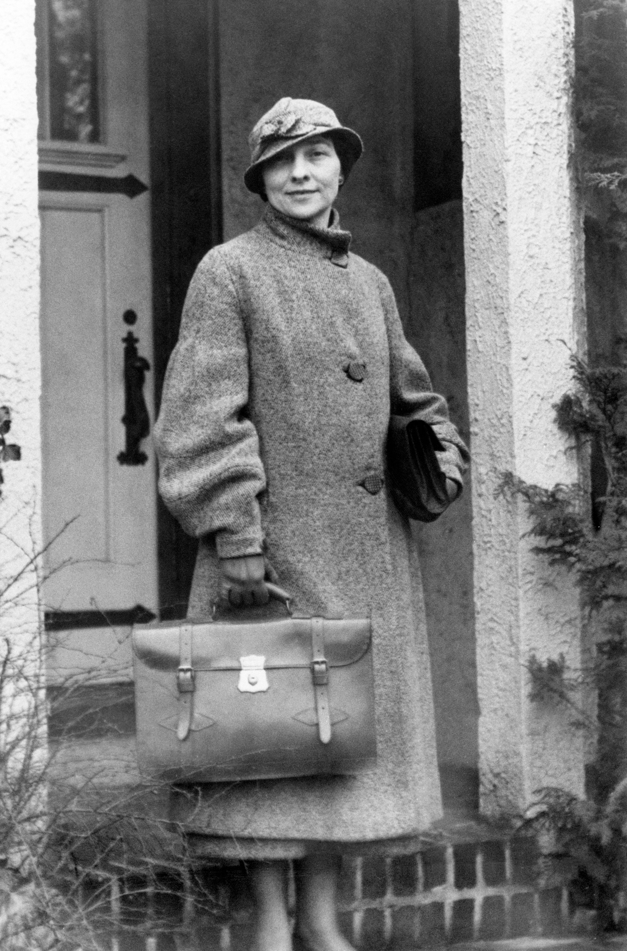
Elizabeth Smith Friedman America's First Female Cryptanalyst

Slide 24
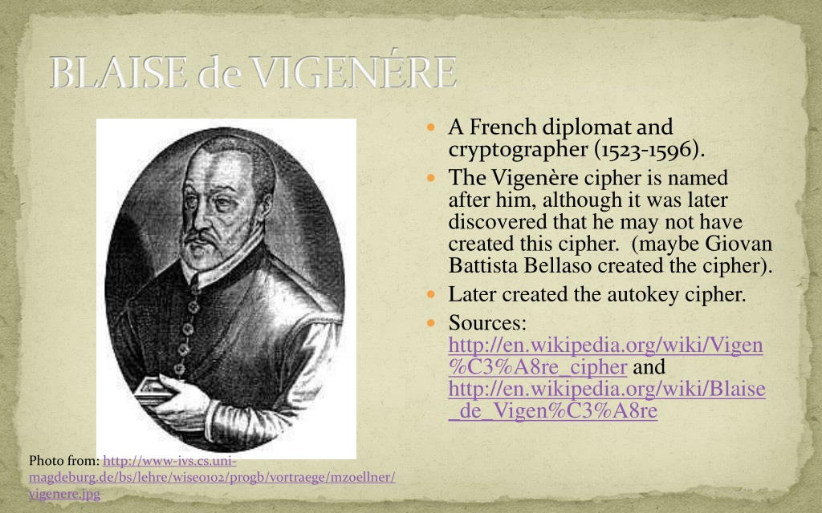
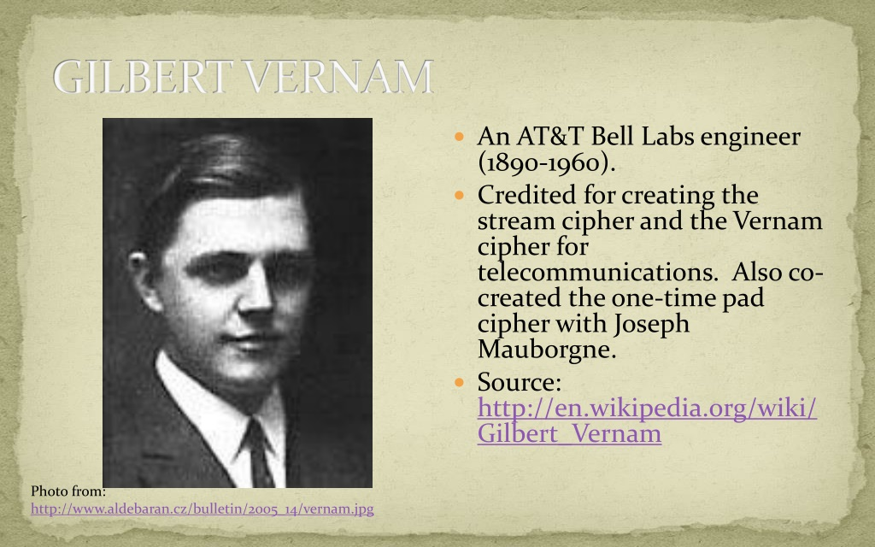
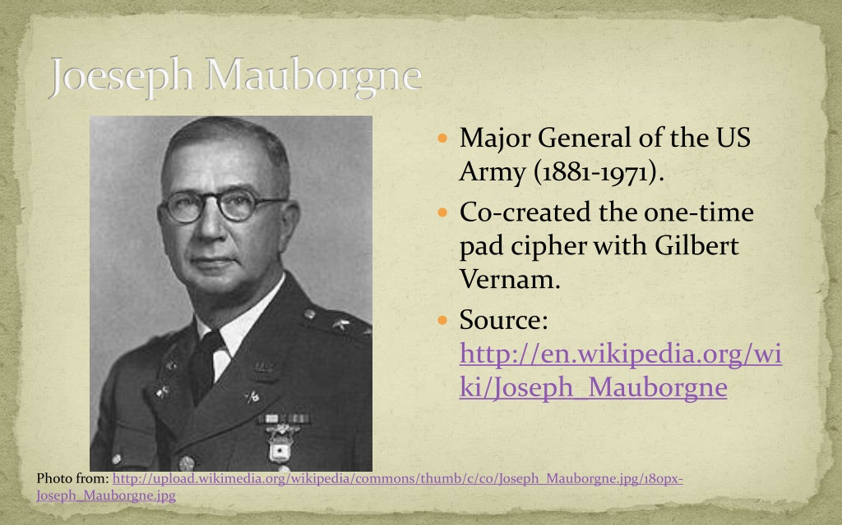
Blaise de Vigenere, Gilbert Vernam and Joseph Mauborgne
Blaise de Vigenere (1523-1596). A French diplomat and cryptographer. Created the Vigenere cipher
Gilbert Vernam (1890-1960): An AT&T Bell Labs engineer, credited with creating the stream cipher, and co-created the one-time pad (OTP).
Joseph Mauborgne (1881-1971): Major General US Army, co-created the one-time pad.

Slide 25
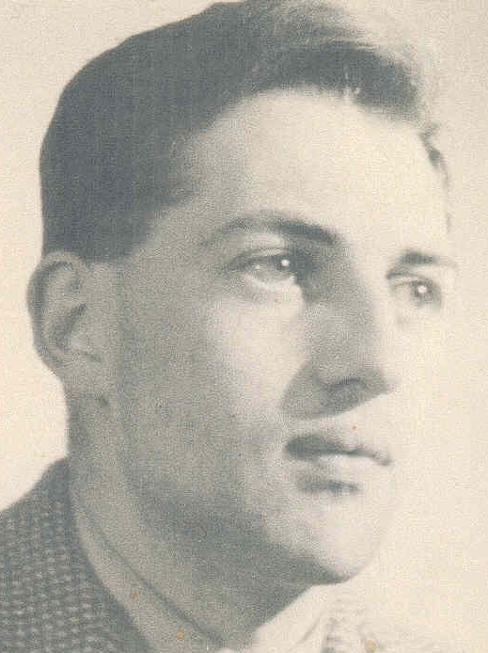
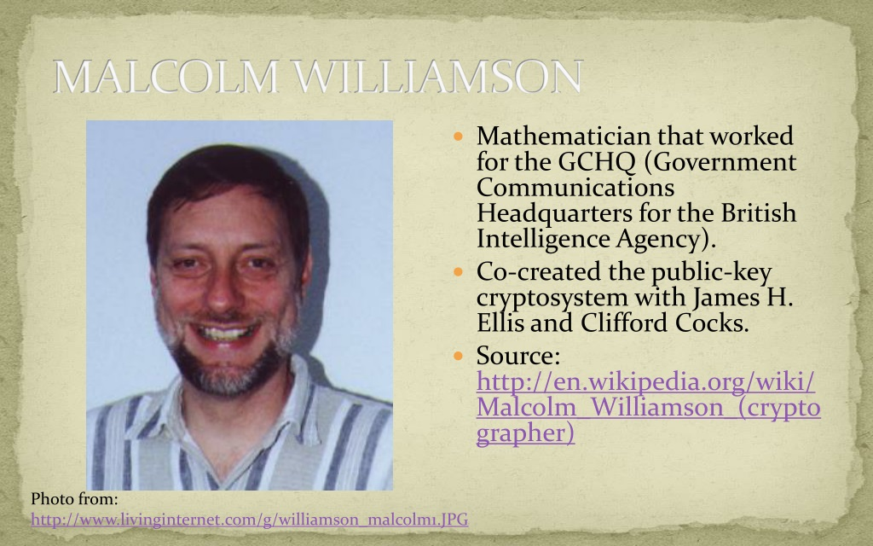
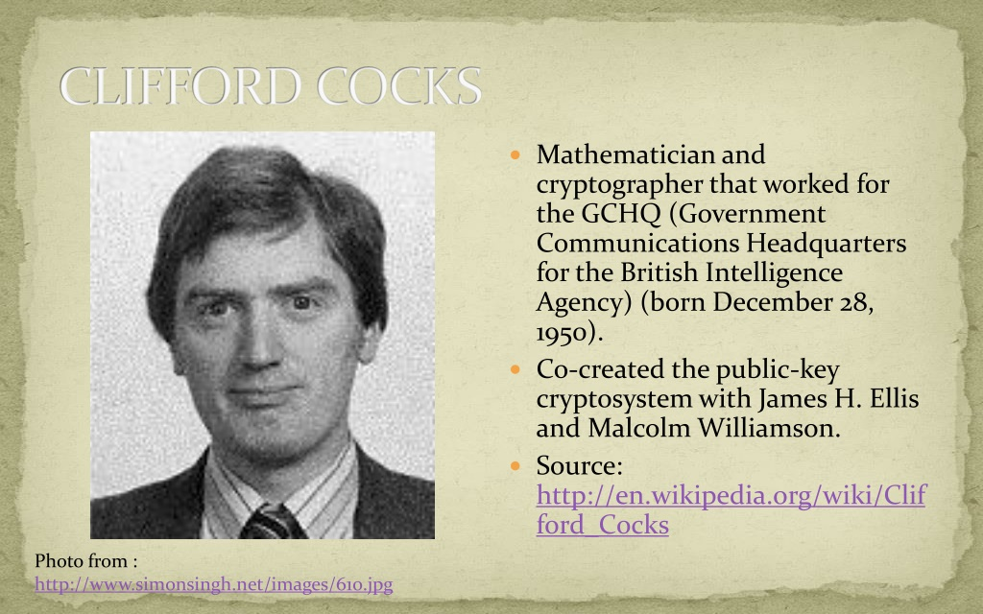
The GCHG cryptographers
James Ellis (1924-1997): engineer, mathematician who worked for the British Intelligence Agency (GCHQ). Co-created the public-key cryptosystem with C. Cox and M. Williamson
Malcolm Williamson, mathematician, worked at GCHQ, co-created the public key cryptosystem.
Clifford Cox, mathematician. Cryptographer, worked at GCHQ, co-created the public key cryptosystem.

Slide 26
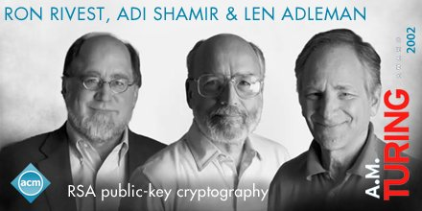
Rivest-Shamir-Adelman

Slide 27
Security Services Architecture and Glossary
International Telecommunication Union (ITU)
X.800, Security Architecture for Open Systems Interconnection
Request for Comments
RFC 4949 , Internet Security Glossary

Slide 28
X.800 Service Categories (OSI)
Authentication
Access control
Data confidentiality
Data integrity
Nonrepudiation

Slide 29
1. Authentication
Peer entity authentication: Assures the recipient that the message is from the source that it claims to be
Data origin authentication: Assures the sender and receiver are authentic and that the connection is not interfered with

Slide 30
2. Access Control
Access to host systems and applications via communications links is controlled

Slide 31
3 Data Confidentiality
Transmitted data is protected from passive and active attacks
Traffic flow is protected from analysis

Slide 32
4 Data Integrity
Applies to single messages, a stream of messages, or selected fields within a message
Messages are received as sent with no duplication, insertion, modification, reordering, or replays

Slide 33
5 Nonrepudiation
The sender or receiver cannot deny a transmitted message
The receiver can prove that the sender in fact sent the message
The sender can prove that the receiver in fact received the message

Slide 34
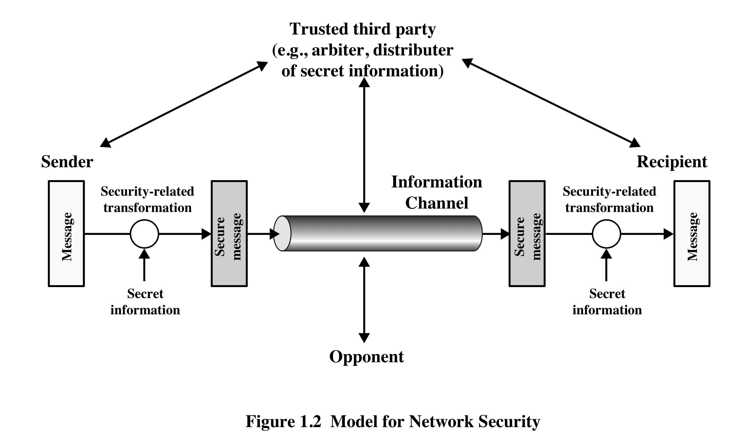
Model for Security I
Scrambled
message
Scrambled
message

Slide 35
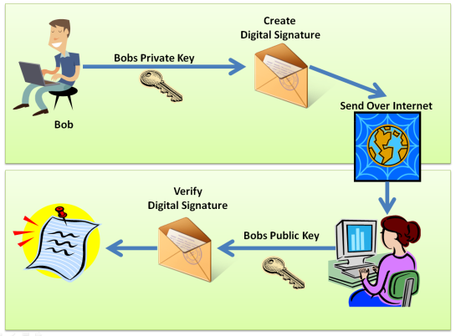
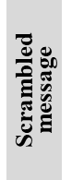
Model for Security II
same key

Slide 36
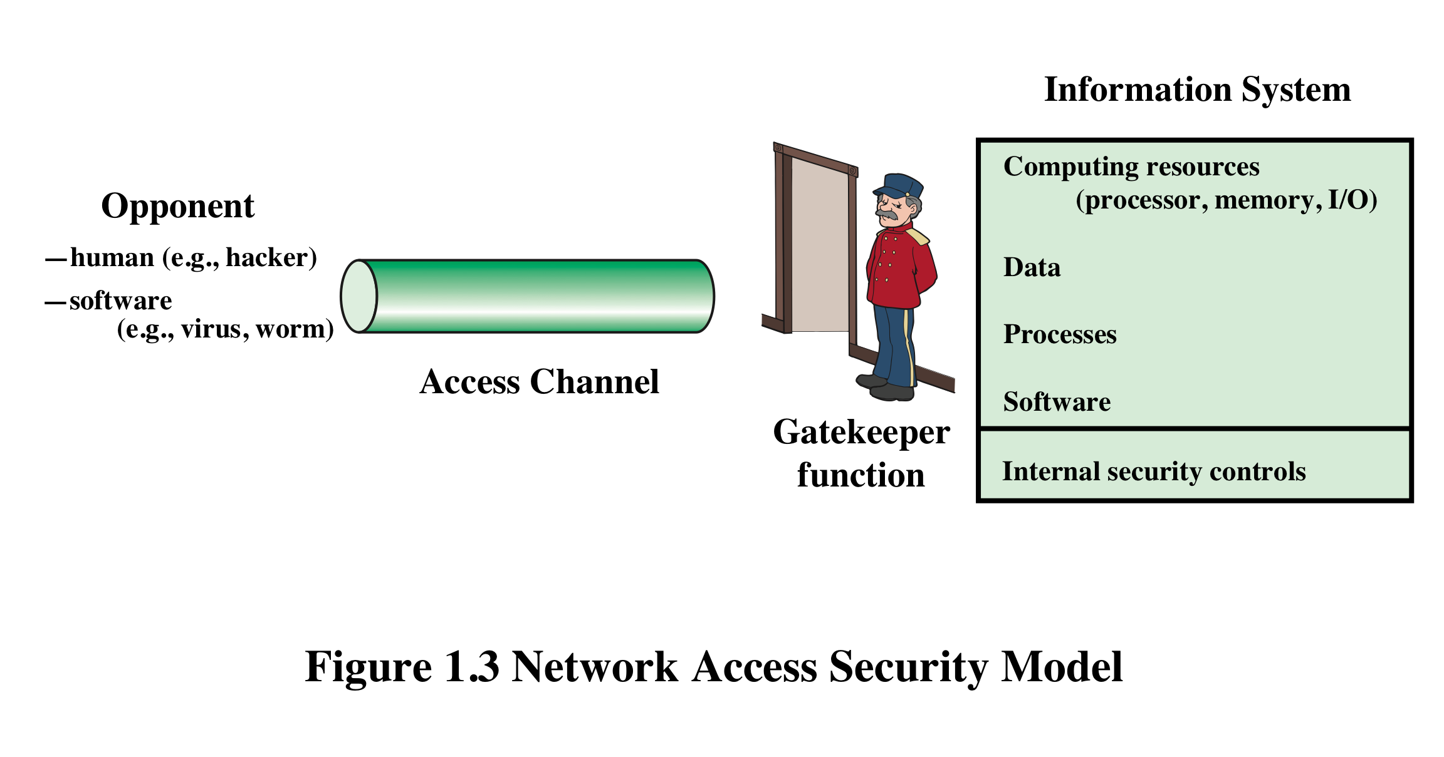
Access Control

Slide 37
Malicious Access
Placement of malware in a computer system that exploits its vulnerabilities.
Two kinds of threats:
Information access threats
Intercept or modify data
Service threats
Exploit service flaws in computers

Slide 38
Summary
Computer security concepts
Security attacks
Passive attacks
Active attacks
Security models
Security services
Confidentiality
Integrity
Availability
Authentication
Nonrepudiation
Access control

